Slide 1
EMOTIONS ON SOCIAL MEDIA USING NLP
By
Nagaraju illuri

Slide 2
Capstone PROJECT 2:-
Project Goals:-
In this project, I'm going to preprocess and clean data, run exploratory data analysis (EDA) and find descriptive statistical measurements as analysis data with making an PREDICTIVE MODEL on emotion using a dataset which has more than 1000000+ Records.
Language, libraries, tools:
Language: Python
Libraries: Pandas, NumPy, tensor flow
IDE: Jupyter Notebook

Slide 3
Data COLUMNS:-
target:-This could refer to the target variable or label in a machine learning context. For sentiment analysis, for example, it might represent the sentiment polarity (positive, negative, neutral) of a tweet.
ids:-This likely represents the unique identifier or ID associated with each tweet.
Date :-This represents the date and time when the tweet was posted.
flag :-This could refer to a flag or indicator associated with the tweet, although its specific meaning may vary depending on the context of the dataset
user:-This represents the username or handle of the Twitter user who posted the tweet.
Tweettext :-This likely refers to the main text or body of the tweet.

Slide 4
DATA SOURCES
PRIMARY DATA:- the primary data in these columns are the tweet text ("TweetText"), user identifiers ("user"), timestamps ("date"), and potentially labels or target variables ("target") depending on the specific task the dataset is intended for.
SECONDARY DATA: the remaining columns such as (‘flags’) and (“idS”) which are not very useful in predictive analysis so that is the reason we name them as secondary data

Slide 5
methodology
The methodology for emotions prediction using Natural Language Processing (NLP) involves several key steps. Firstly, the dataset containing social media text data is collected and preprocessed to remove noise, such as punctuation and stopwords, and to standardize text formatting. Next, feature extraction techniques, such as TF-IDF (Term Frequency-Inverse Document Frequency) or word embeddings, are applied to represent the text data in a numerical format suitable for machine learning algorithms.
Subsequently, machine learning models, such as Support Vector Machines (SVM), Random Forests, or Neural Networks, are trained on the preprocessed and transformed text data to predict the emotional sentiment or category associated with each piece of text. The models are evaluated using appropriate metrics, such as accuracy, precision, recall, or F1-score, to assess their performance. Additionally, techniques like cross-validation and hyperparameter tuning may be employed to optimize model performance. Finally, the trained models are deployed to make predictions on new, unseen text data, enabling real-time analysis and monitoring of emotions expressed on social media platforms.

Slide 6
tools and technologies
EXCEL FOR DATA EXTRACTION
Jupyter notebook for building mofr

Slide 7
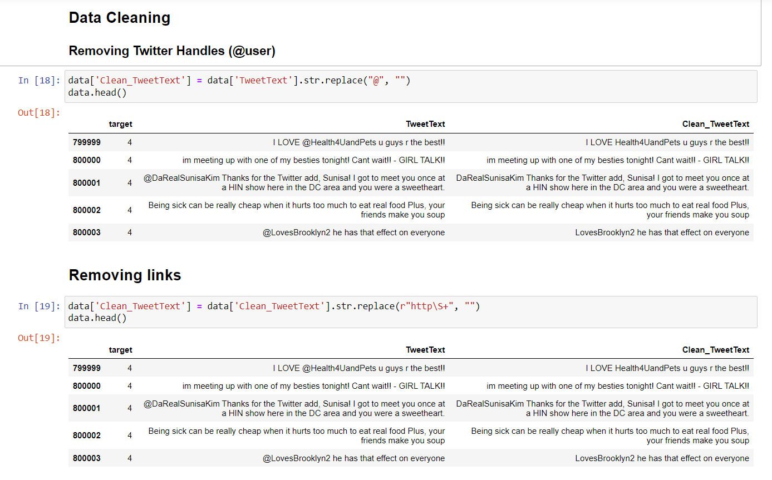
outcomes

Slide 8
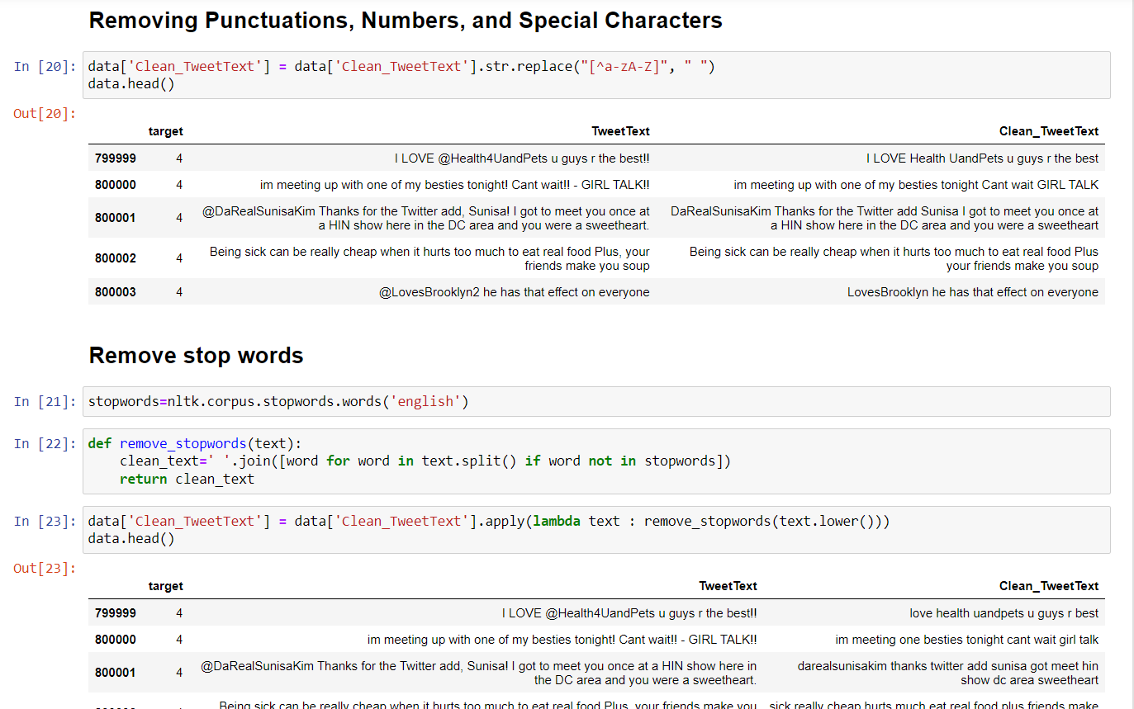
outcomes

Slide 9
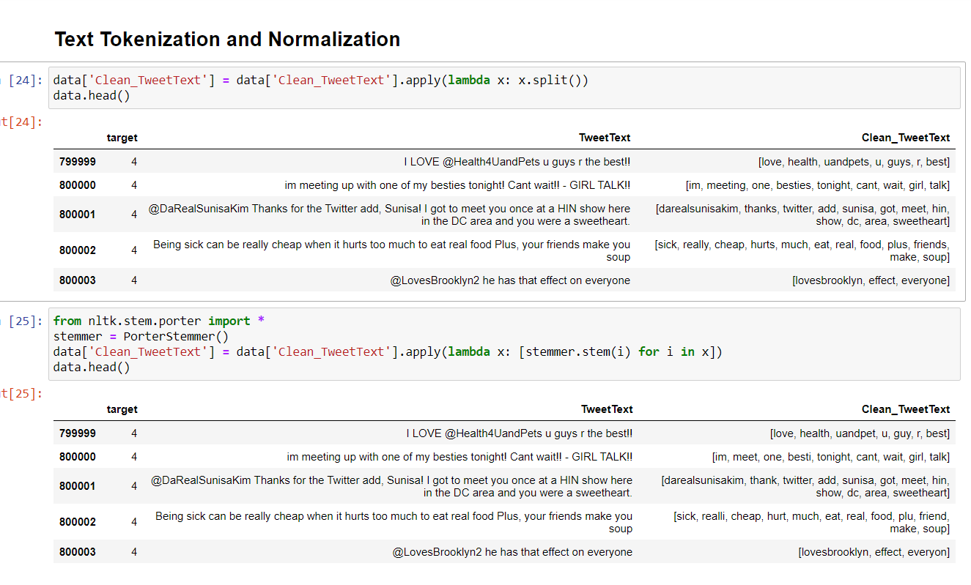
outcomes

Slide 10
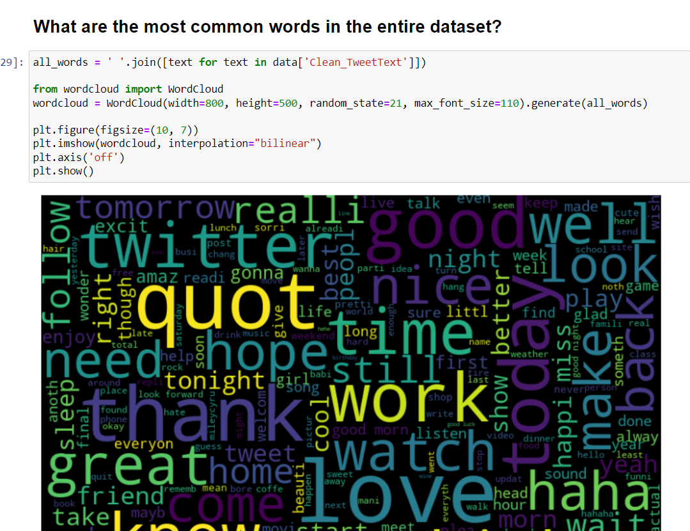
outcomes

Slide 11
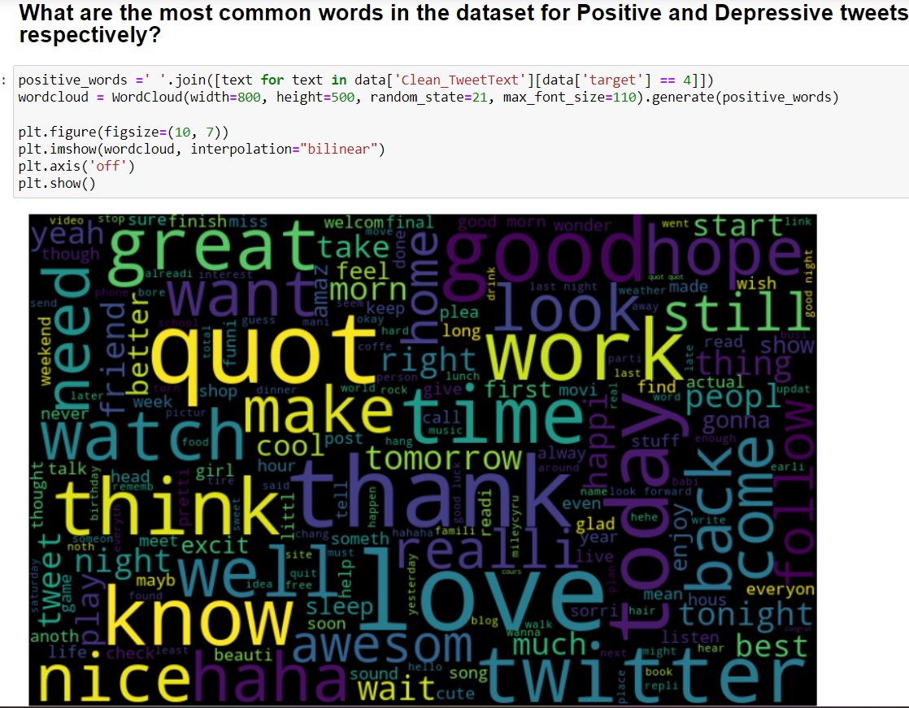
outcomes

Slide 12
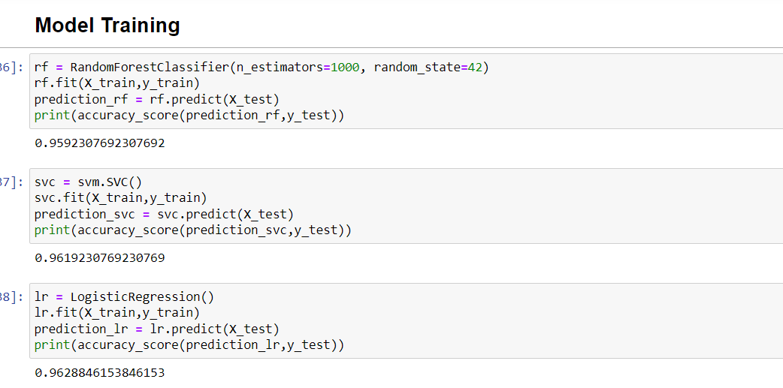
Models accuracy

Slide 13
CONCLUSION
Natural Language Processing (NLP) techniques for emotions prediction in social media holds significant promise for understanding and analyzing human behavior and sentiment in digital environments. By extracting insights from textual data, such as social media posts, comments, and messages, NLP models can accurately classify and predict the range of emotions expressed by users. These predictions not only offer valuable insights into individual and collective emotional states but also enable targeted interventions and personalized experiences in various domains, including marketing, mental health, and social analytics.

